Slide 1
Yield Surface Fitting of Raw DP980 specimens
Thein Lin Aung, Kohki Enomoto, Ninshu Ma
JWRI, Osaka University
2023/02/24

Slide 2
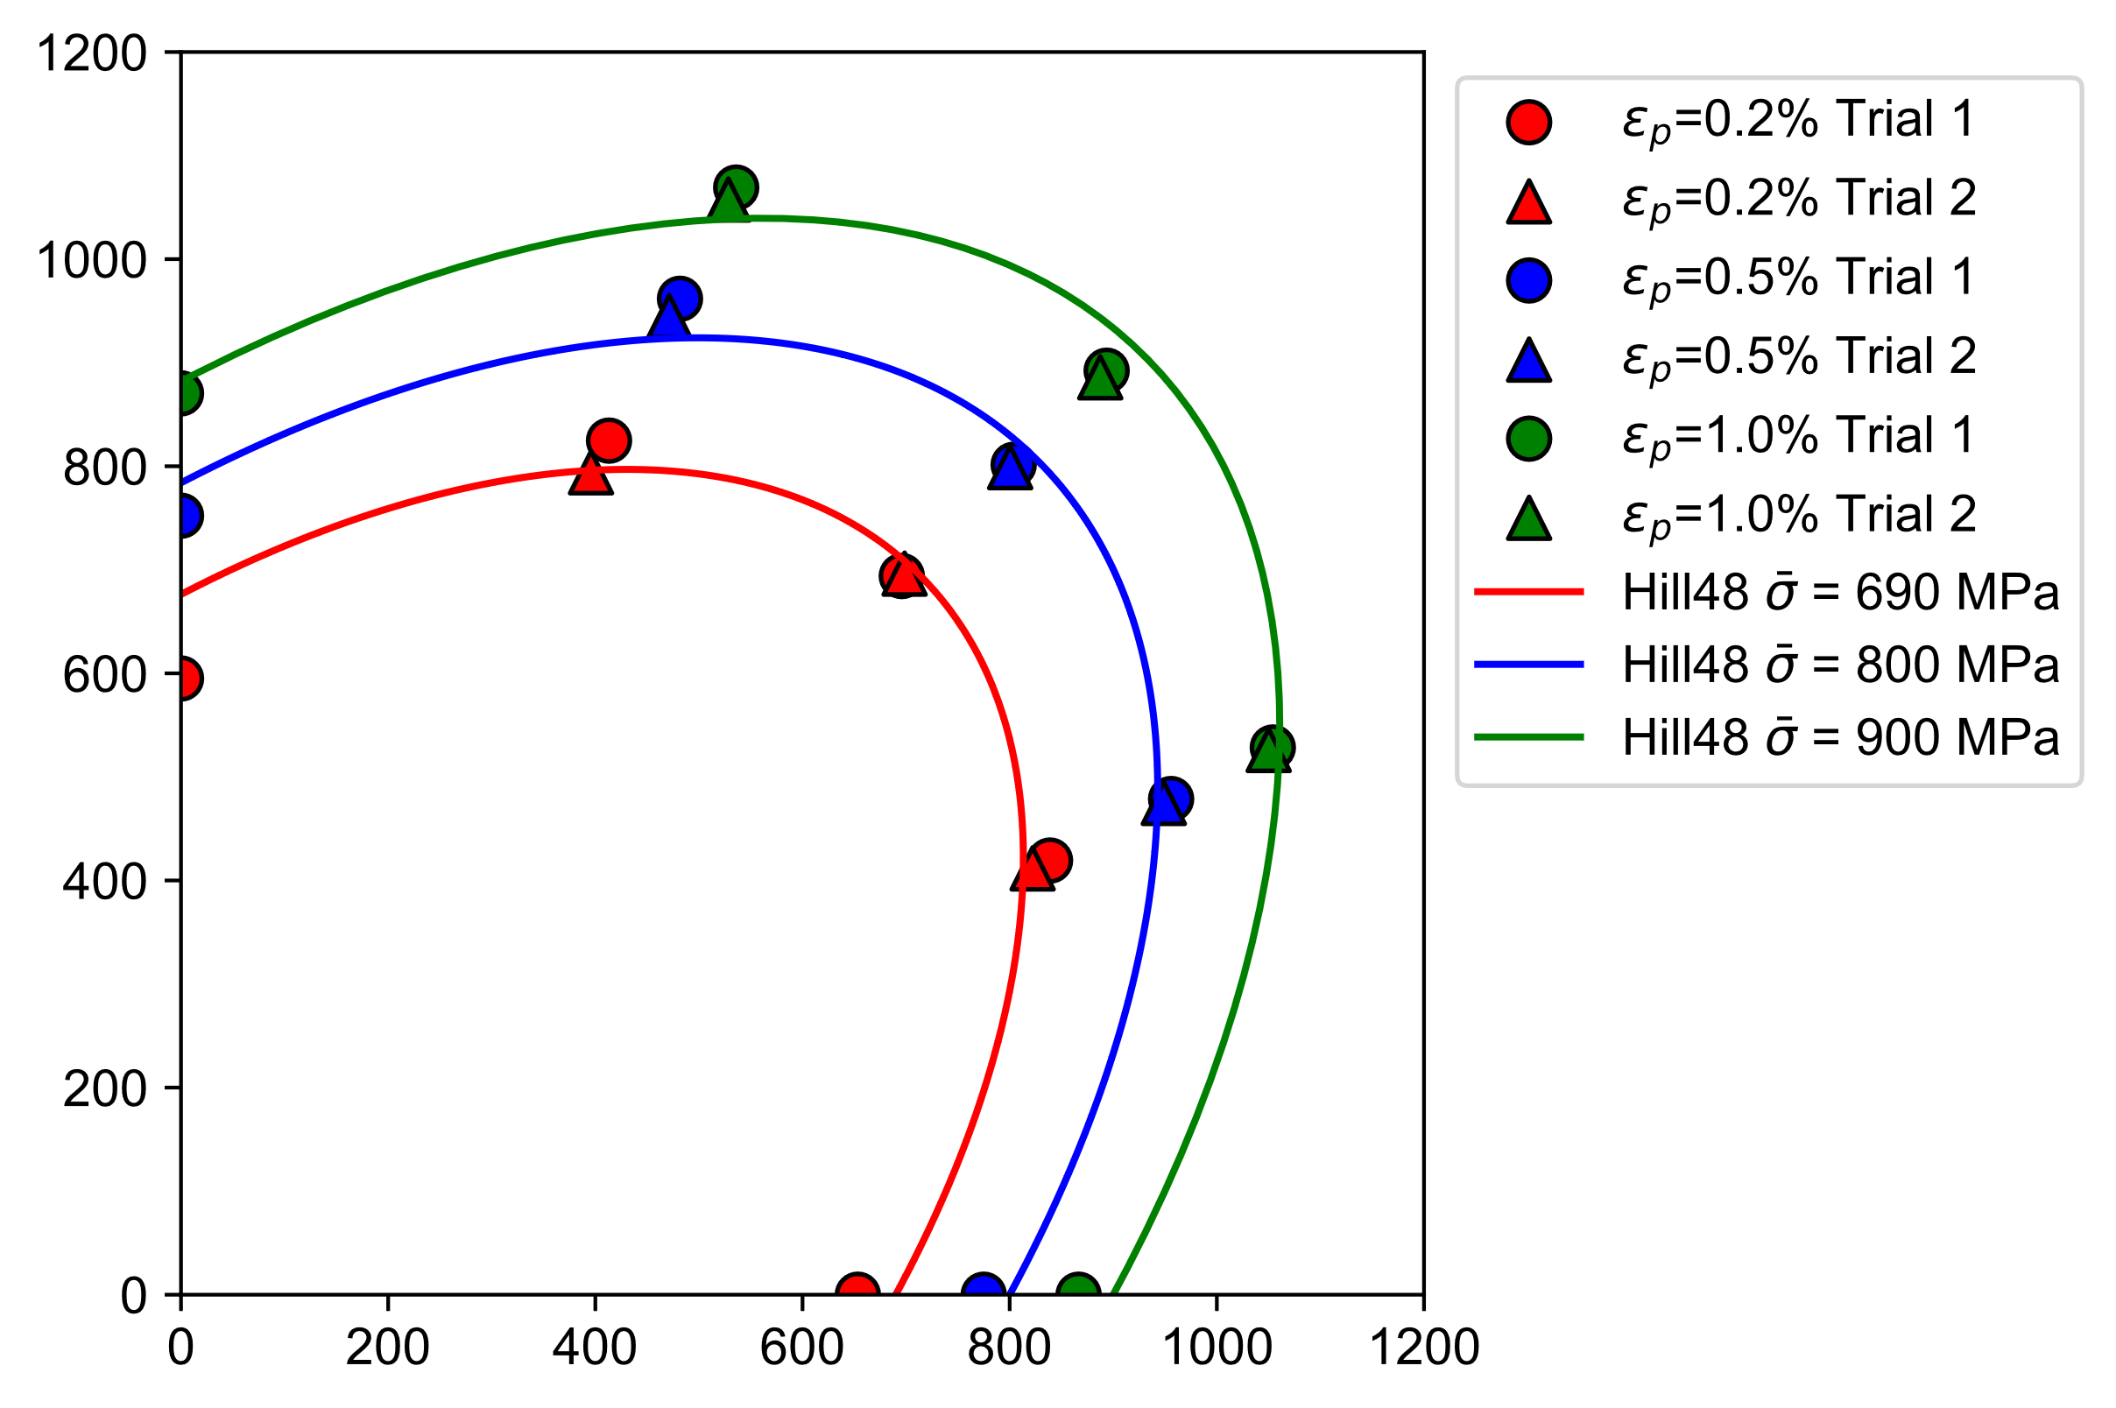
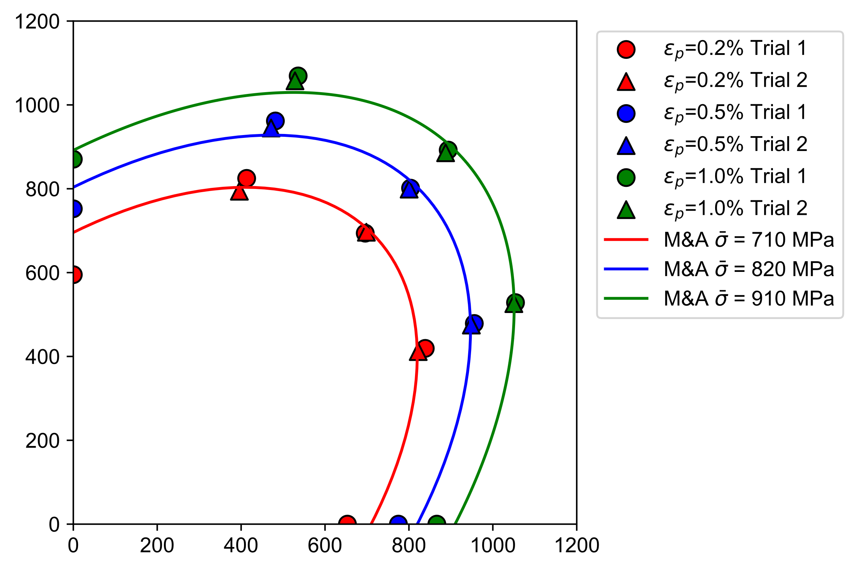
Yield curve fitting of uniaxial and biaxial tensile tests
Hill48
M&A quadratic
Independent equivalent stress values
Independent equivalent stress values
Rx = 1.0
Ry = 0.98
Rxy = 0.99
Rz = 1.0
Uniaxial tests from Honda (1.6 mm specimens)
Biaxial tests from TUAT (0.8mm specimens)

Slide 3
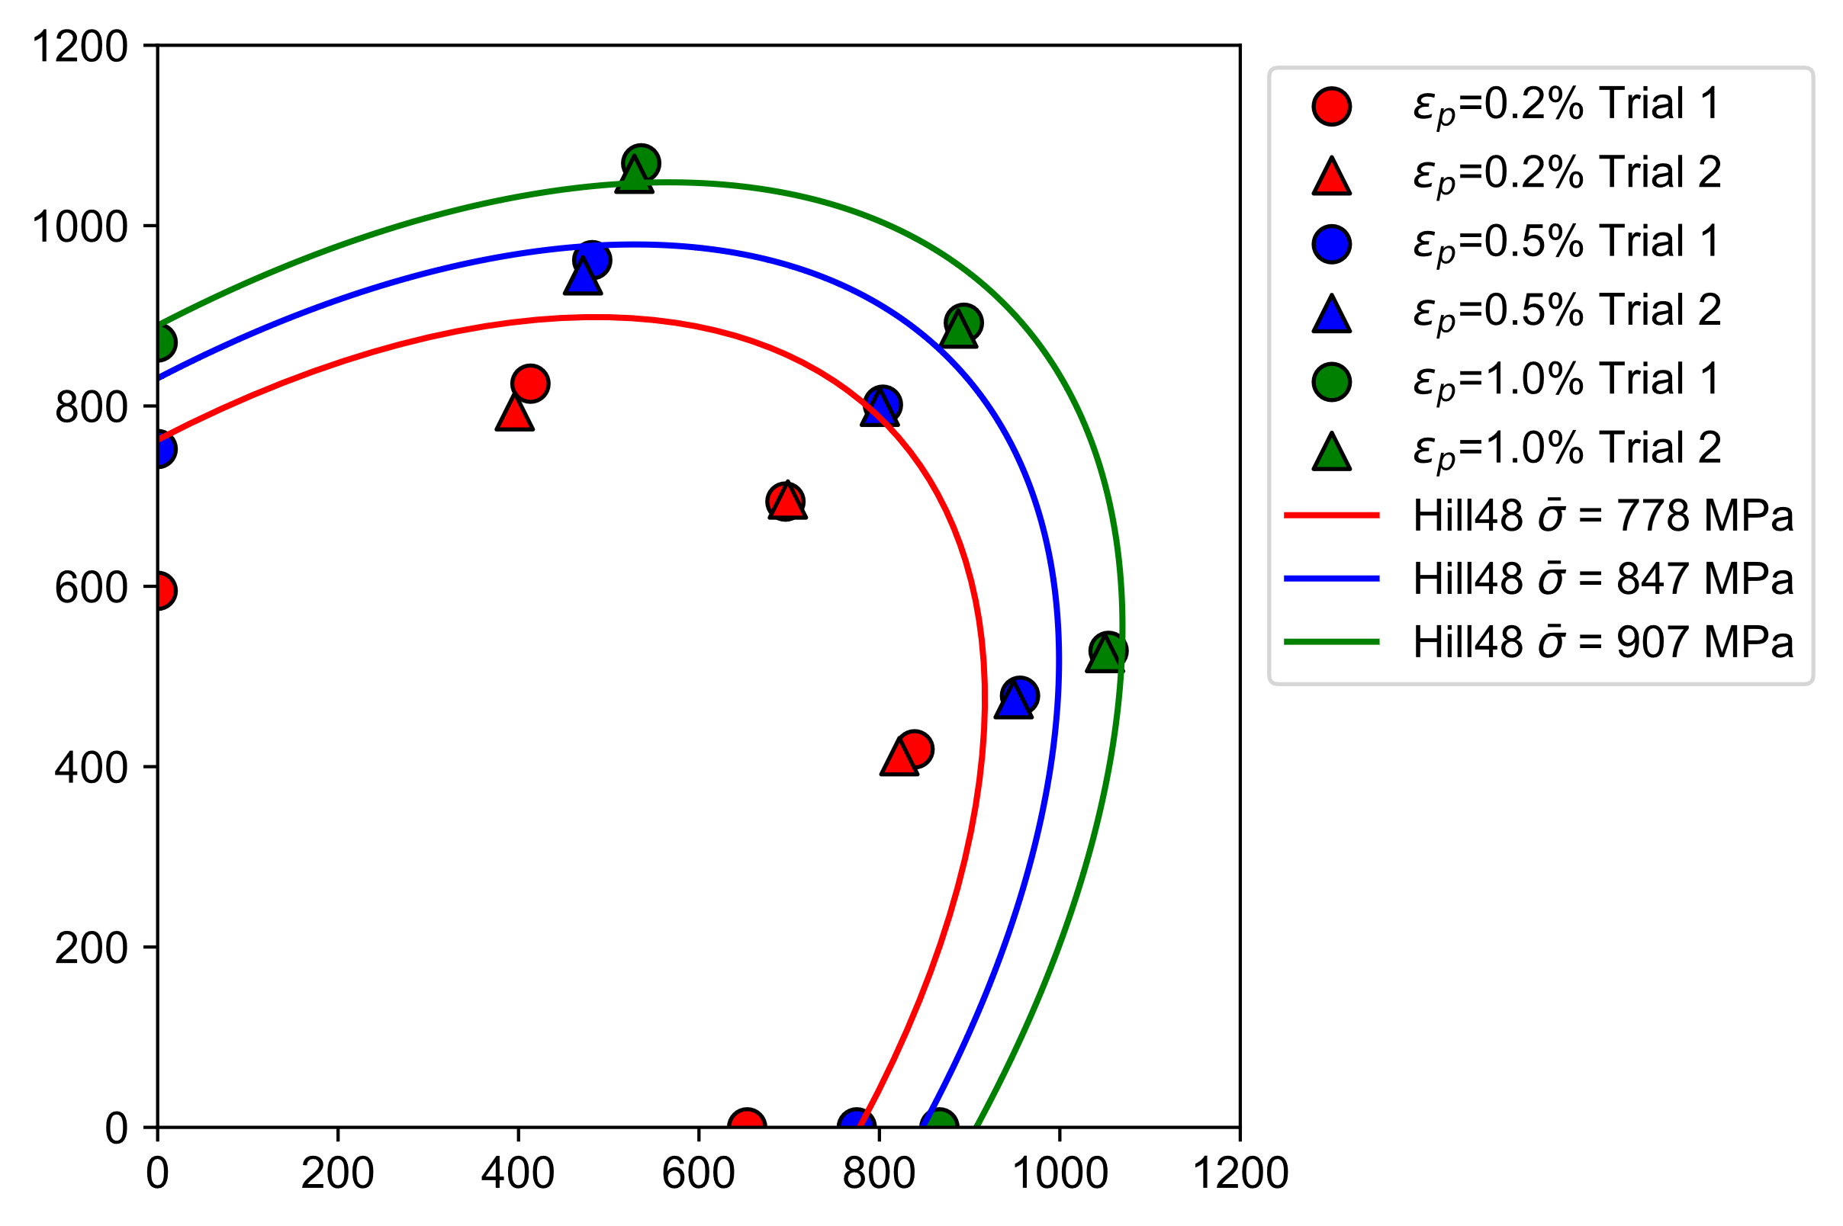
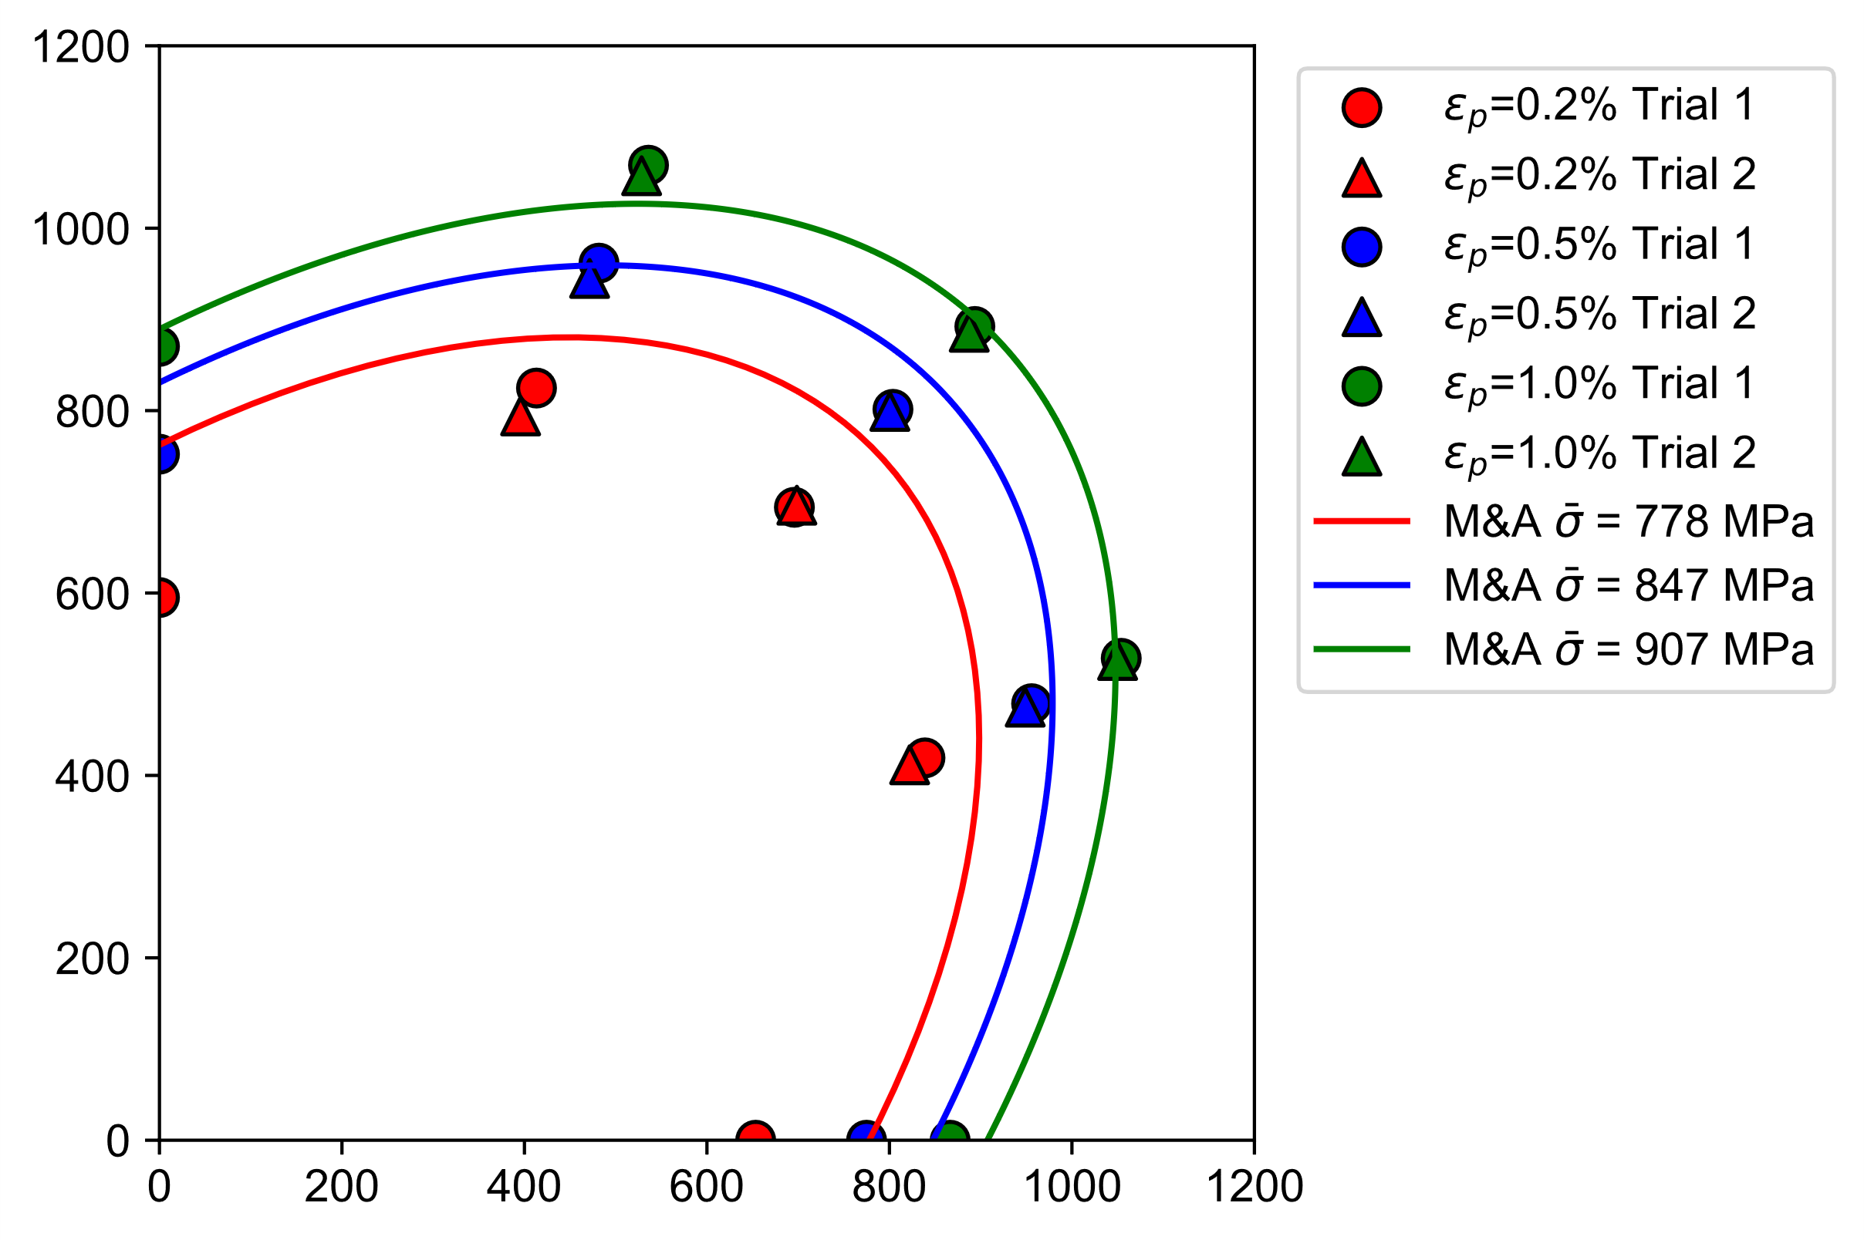
Yield curve fitting of uniaxial and biaxial tensile tests 2
Hill48
M&A quadratic
Equivalent stress from Swift equation (Raw L)
Equivalent stress from Swift equation (Raw L)
Rx = 1.0
Ry = 0.98
Rxy = 0.99
Rz = 1.0
Equivalent stress for the yield curve was calculated from Swift equation of Raw L (Honda’s 1.6mm specimen)
Isotropic hardening is assumed, so YF parameters do not change.

Slide 4
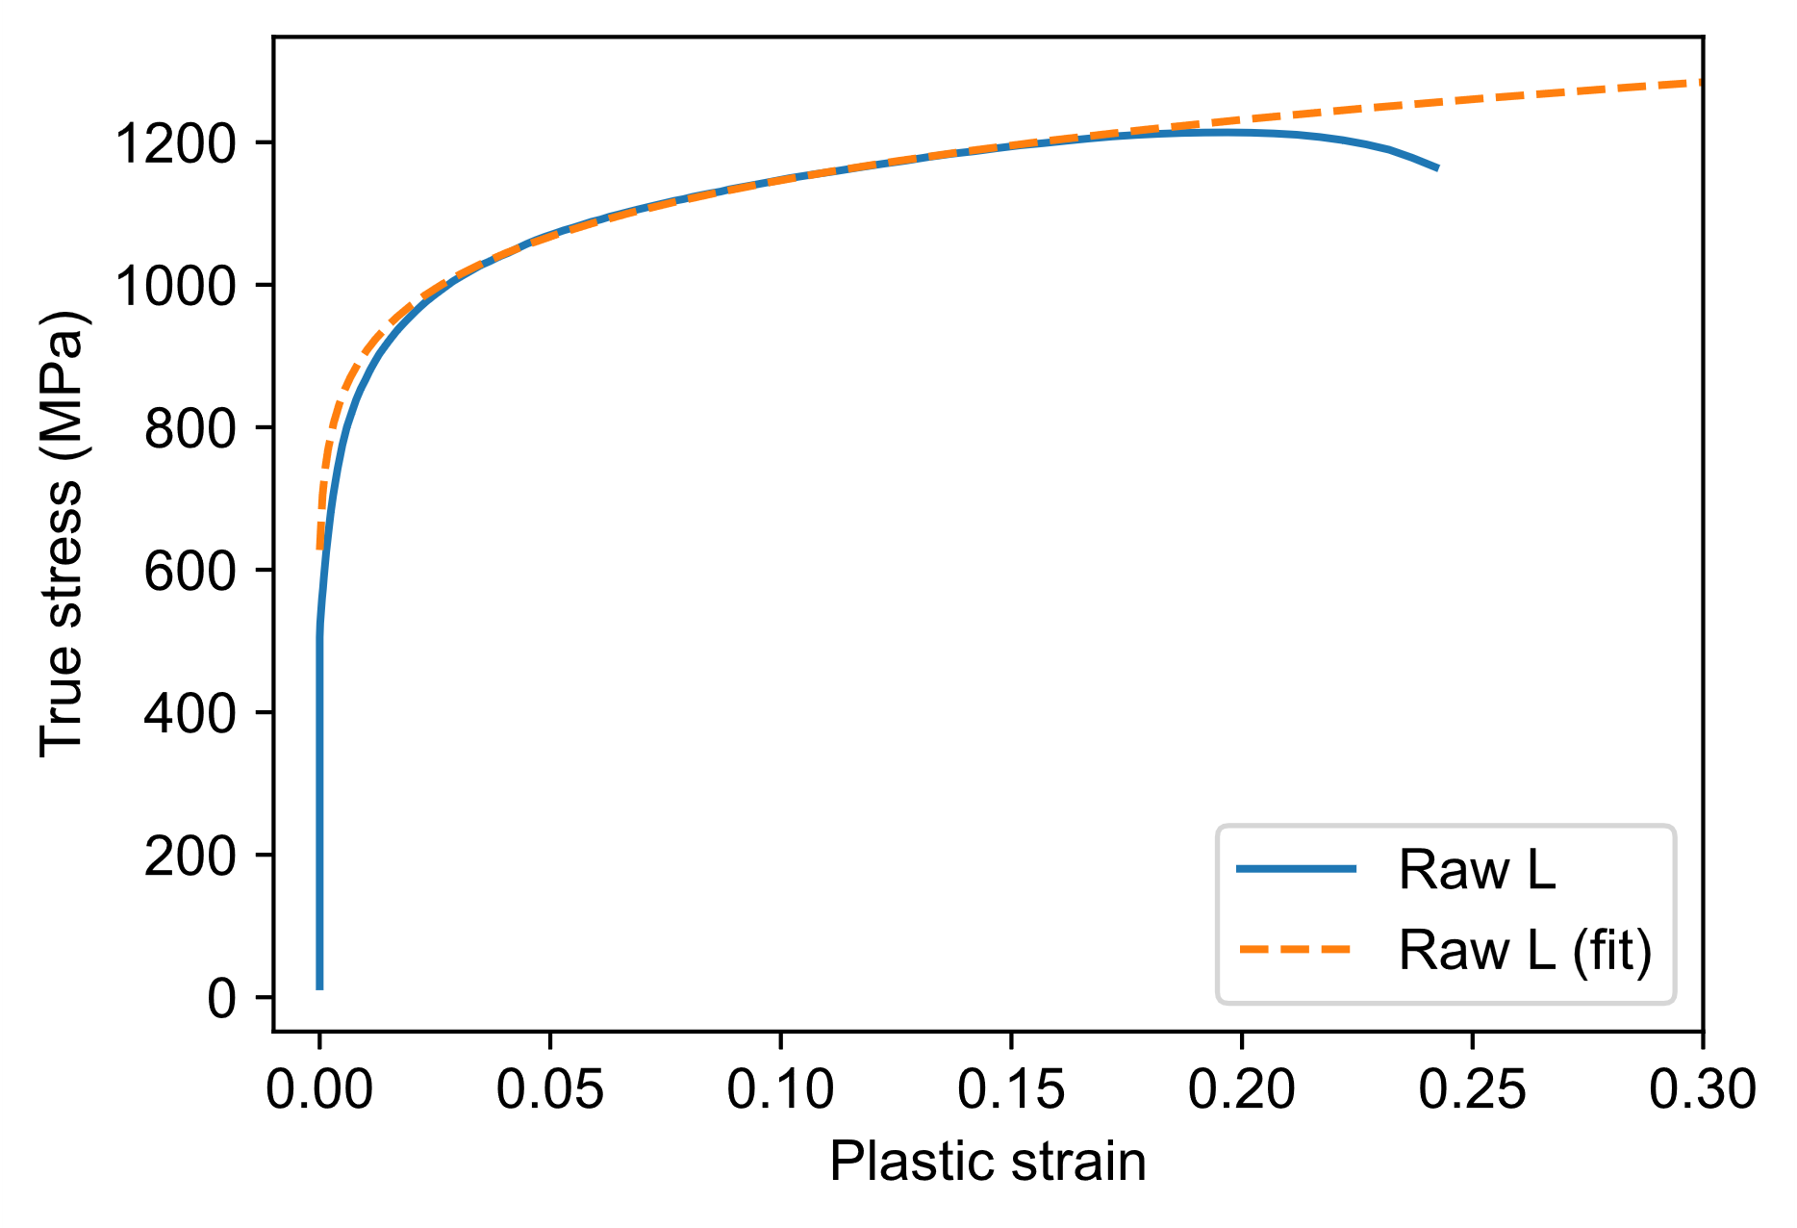
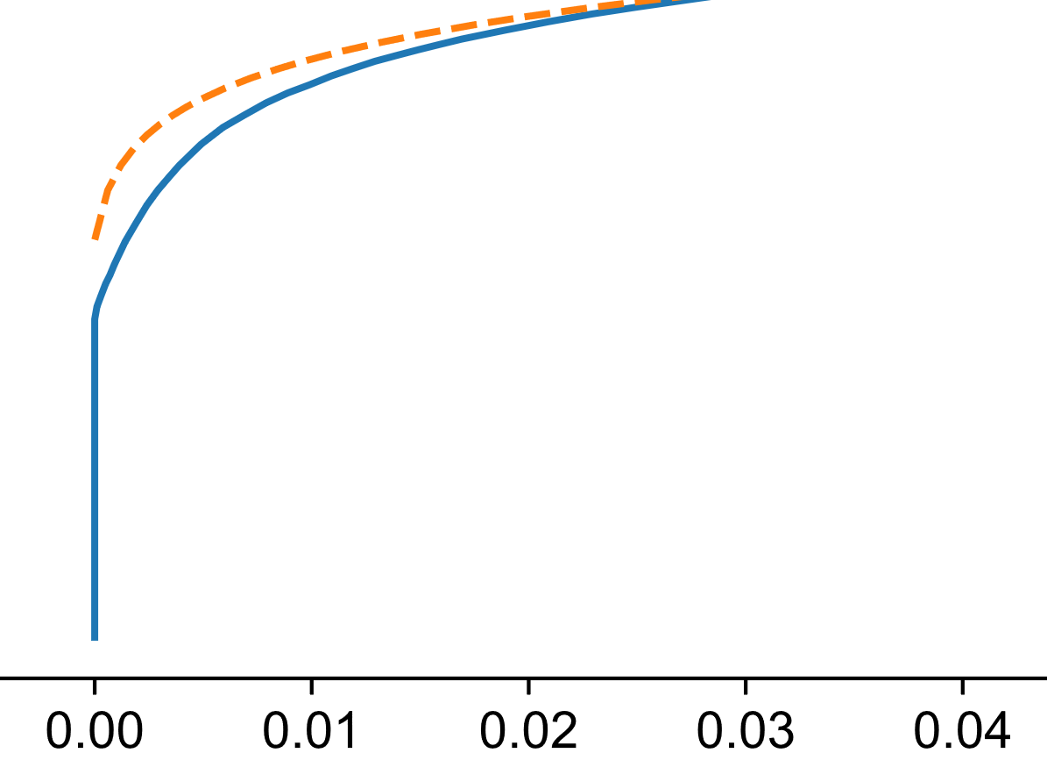
Bad Swift fitting accuracy at small strains
K | 1447
ep0 | 2.74E-05
n | 0.102
The Swift curve’s fitting accuracy is not good for small strains.
If fitting is optimized for small strains, large error occurs at large strains.

Slide 5
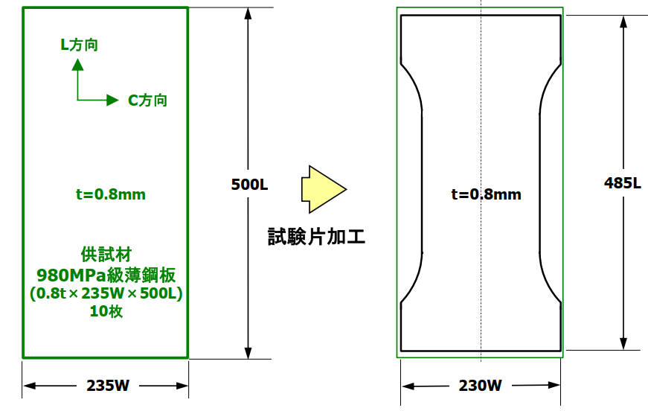
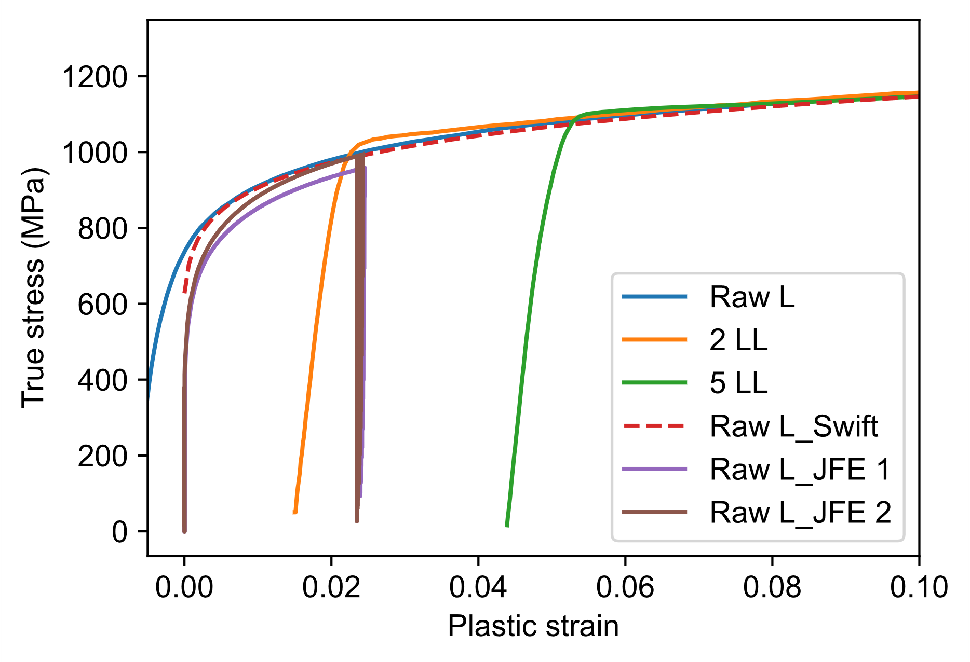
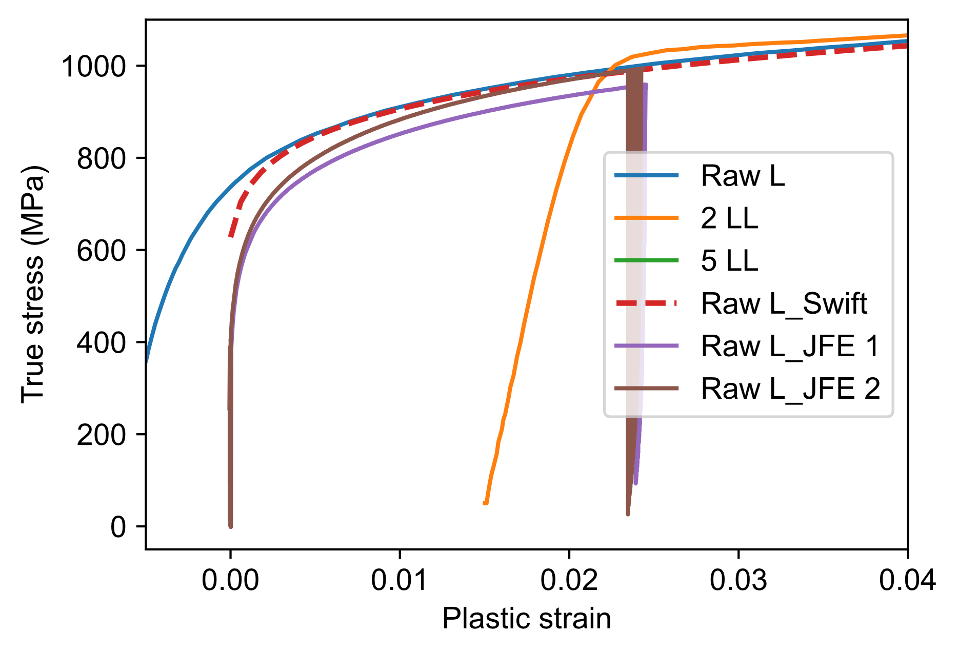
Comparison of Raw L uniaxial SS-curves with 0.8mm large tensile specimen from JFE
K | 1447
ep0 | 2.74E-05
n | 0.102

Slide 6
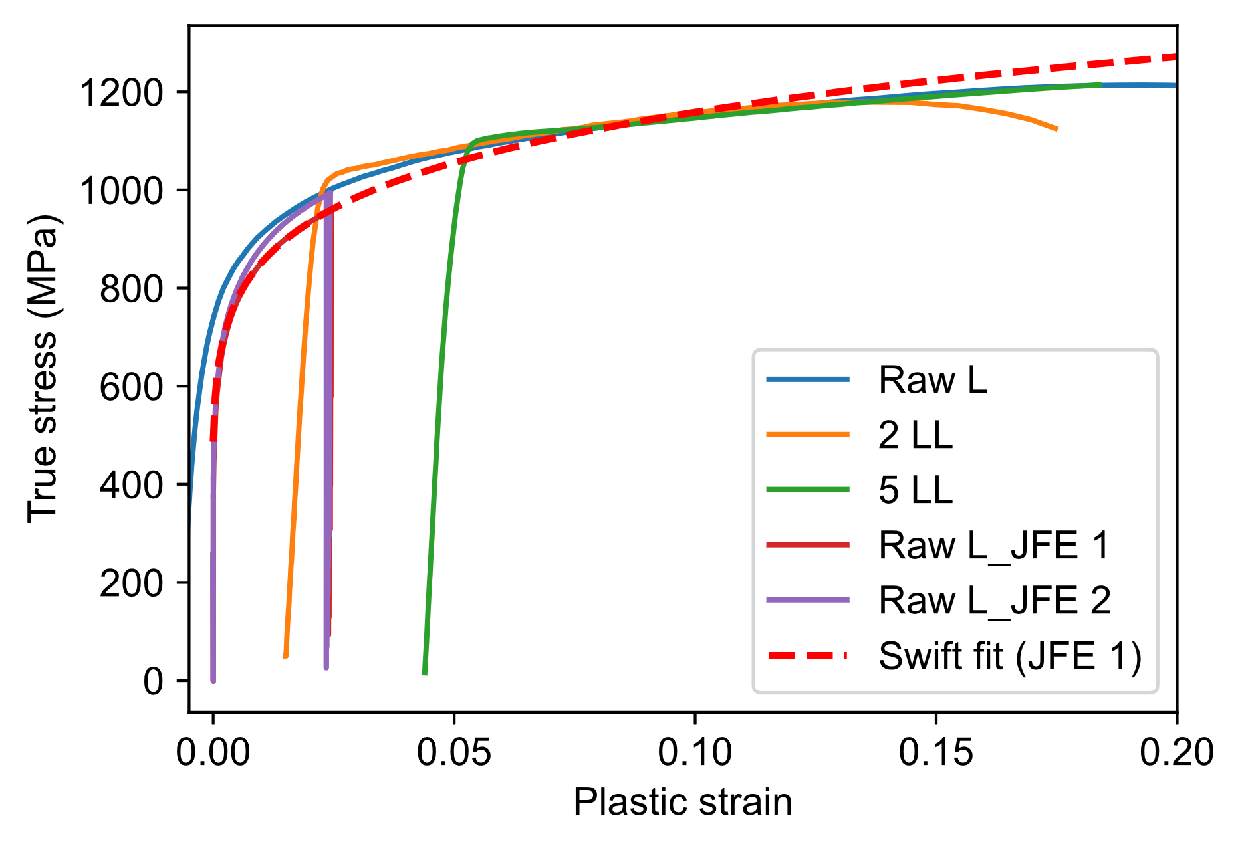
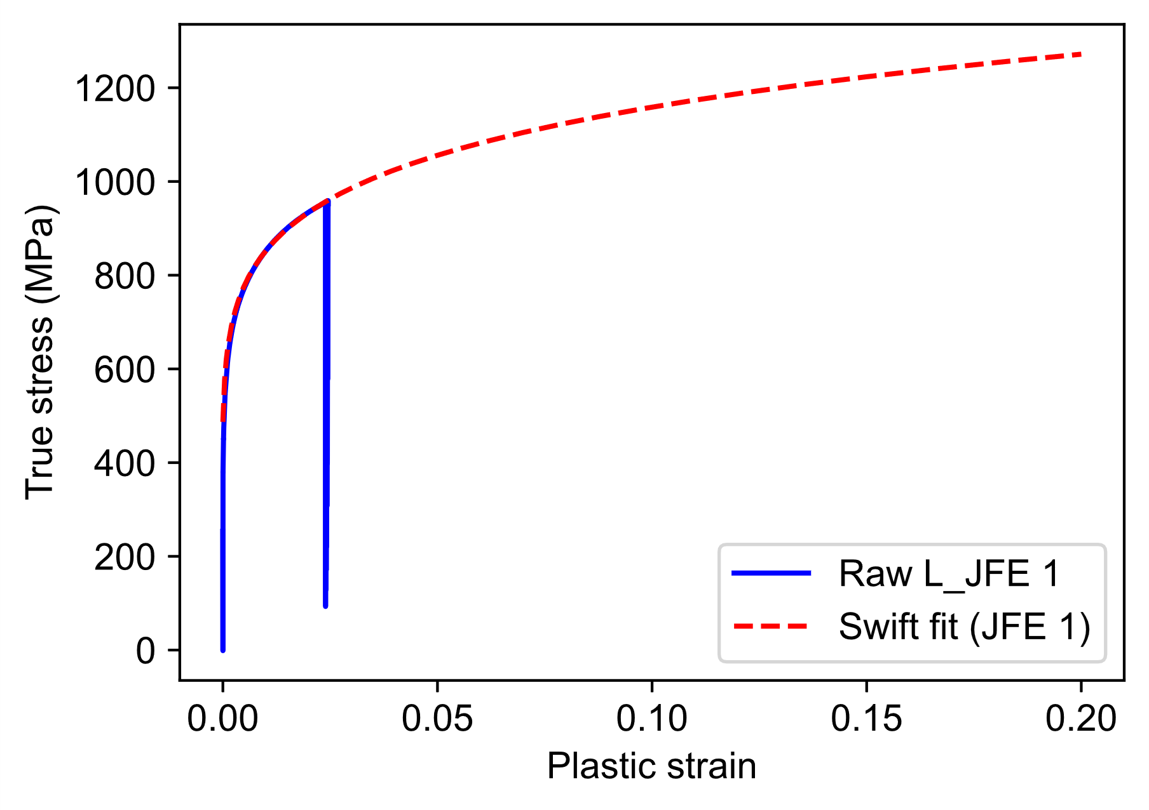
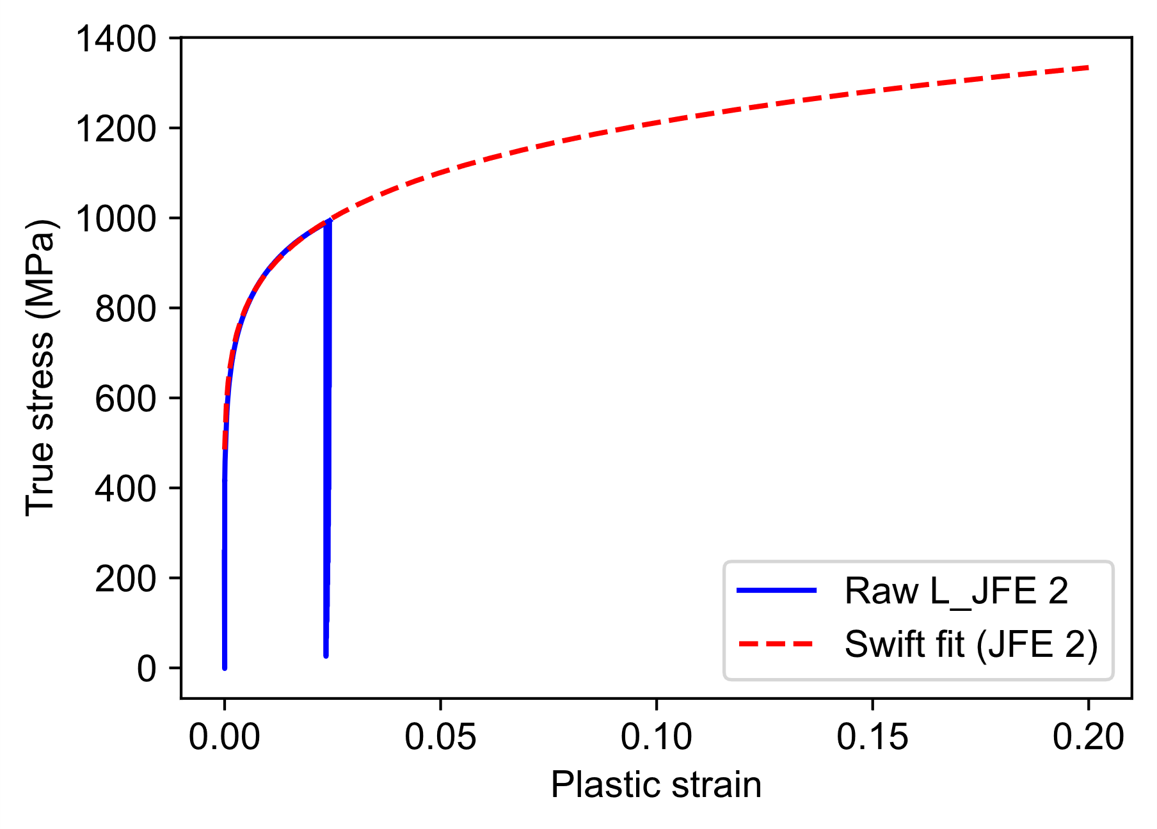
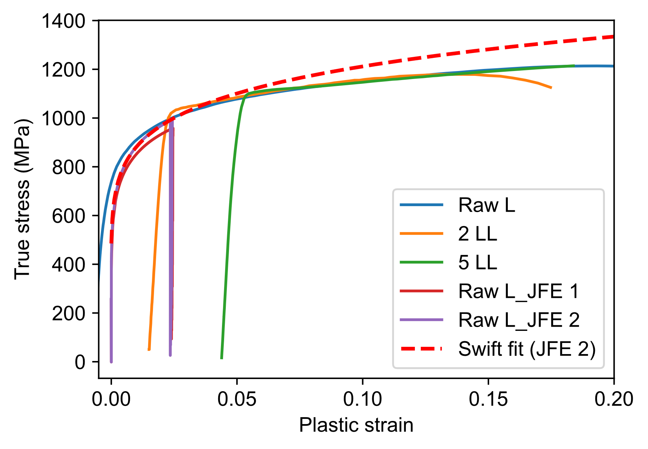
Modification of Swift parameters to fit JFE specimen’s SS-curve
K | 1578
ep0 | 1.577E-04
n | 0.1343
K | 1668
ep0 | 1.374E-04
n | 0.1388

Slide 7
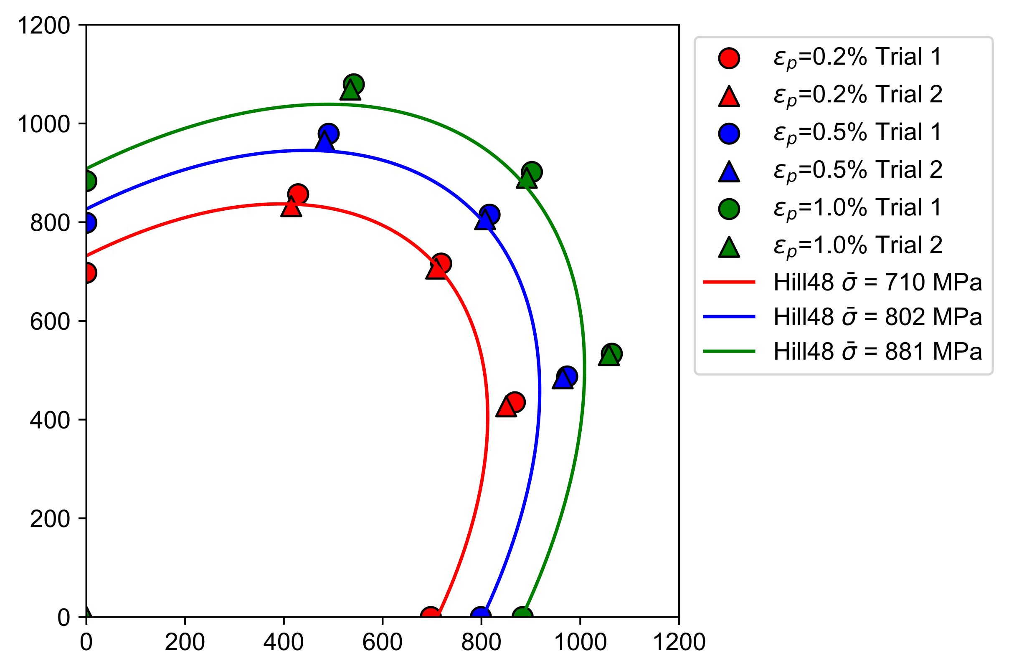
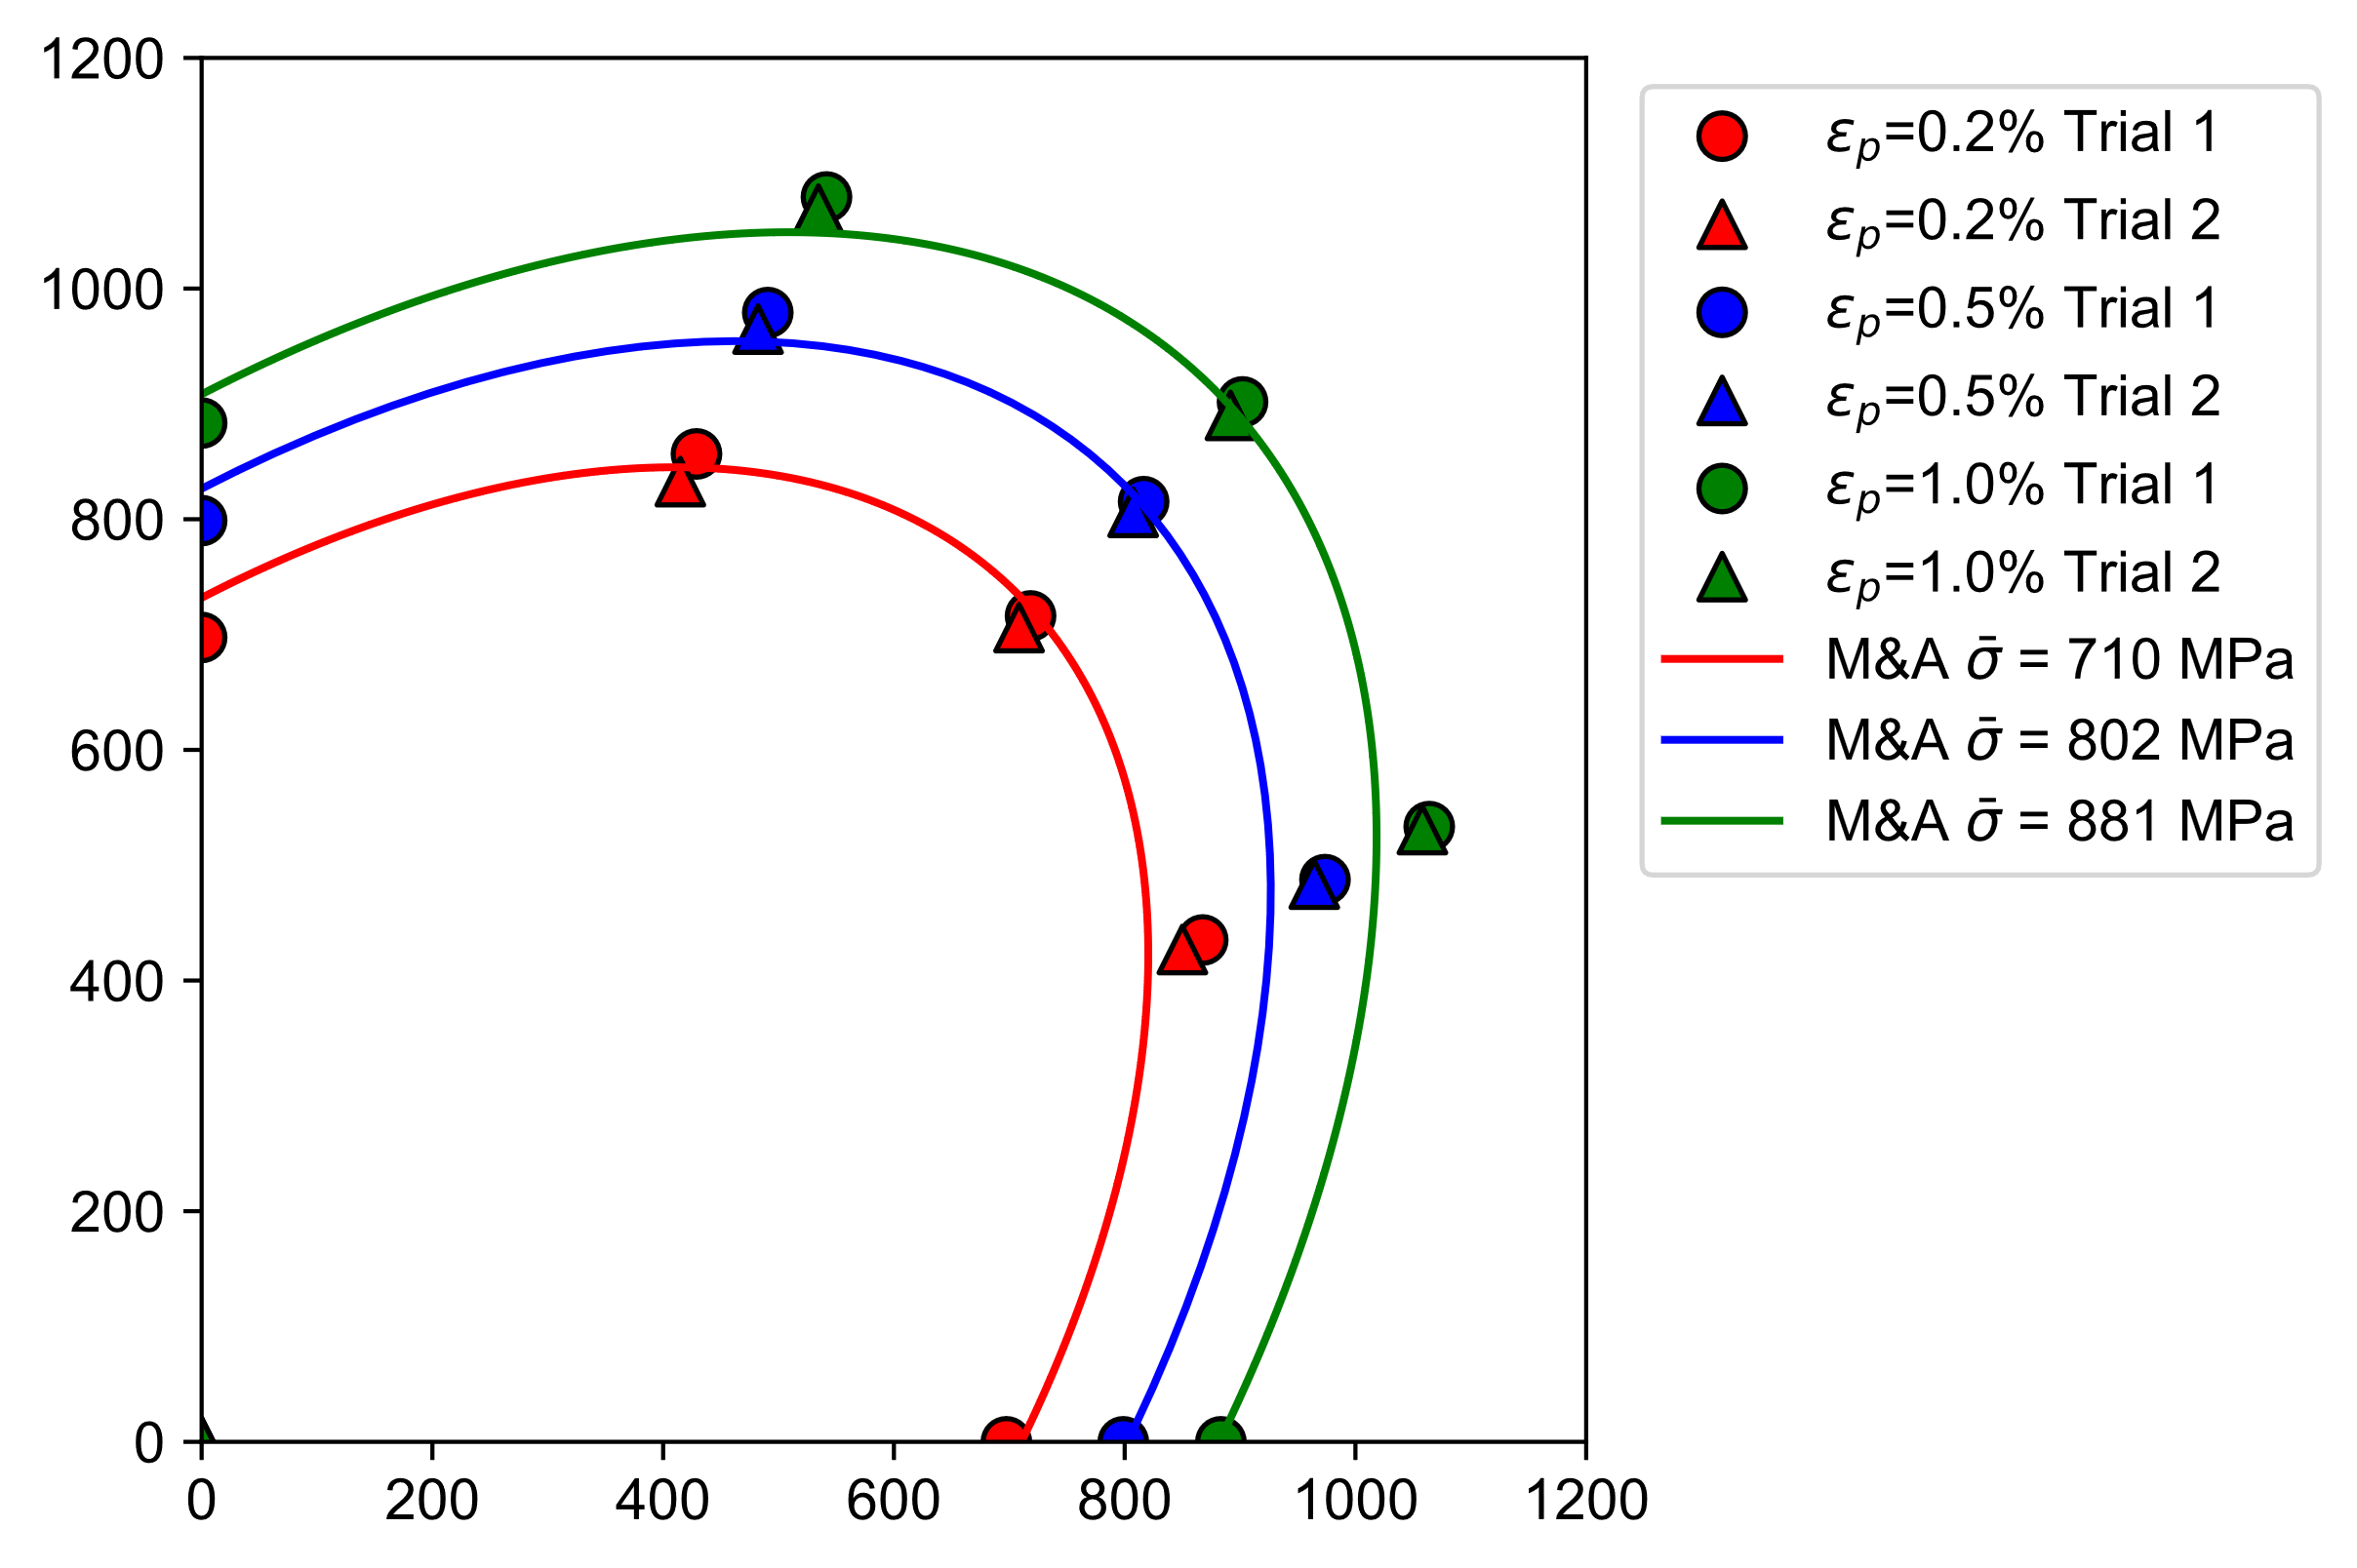
Better fitting accuracy at small strains using optimized Swift parameters (JFE 2)
Hill48
M&A quadratic
Rx = 1.0
Ry = 1.03
Rxy = 1.0
Rz = 1.0
K | 1668
ep0 | 1.374E-04
n | 0.1388

Slide 8










Pre-strain dependent anisotropic hardening (State variables update flow)
equv. plastic strain
loading history variable
$$σ_{x}^{∗}({\overline{ε}}_{p},h)$$
$$σ_{y}^{∗}({\overline{ε}}_{p},h)$$
Uniaxial hardening curves
$$R_{xx}({\overline{ε}}_{p})$$
$$R_{yy}({\overline{ε}}_{p})$$
$$R_{xy}$$
$$R_{z}$$
$$m$$
Yield function parameters
$$\frac{dσ}{{d\overline{ε}}_{p}}$$
Equivalent stress and flow rule
Time step ++
$$\overline{σ}({\overline{ε}}_{p})$$
Return mapping
$${d\overline{ε}}_{p}, dσ, du$$
State update

Slide 9
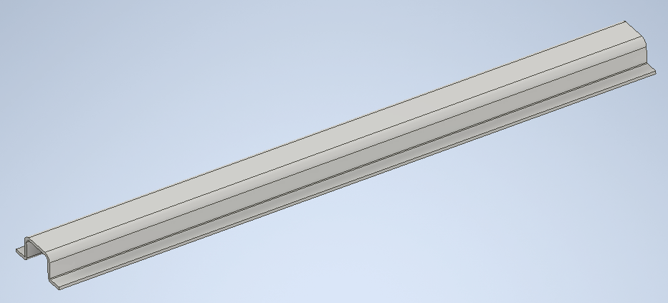
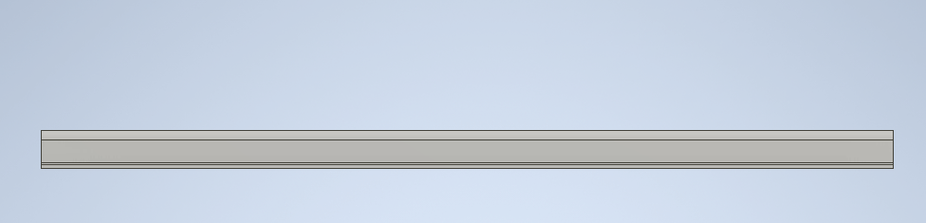
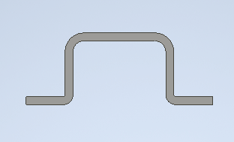
Simulation: 3-point bending model using Isogeometric Analysis (IGA)
Experiment data (Stroke, displacement, strain) and material properties
CAD model => IGA model =>Elastoplastic bending simulation

